Slide 1
EARTHQUAKE DAMAGE IDENTIFICATION IN BUILDINGS USING MACHINE LEARNING ALGORITHM

Slide 2
INTRODUCTION
This project intends to identify the faults in building structures which occur due to earthquake using machine learning algorithm.
This model helps to build smart buildings, which can be made earthquake prone up to some extent.
It can be beneficial for structural health monitoring for engineers.

Slide 3
LITERATURE SURVEY: I PAPER
“Extensive analytical and experimental studies on structural health monitoring and vibration serviceability of stadia are being carried out at Qatar University. One of the main objectives is to develop efficient structural damage detection techniques that are suitable for monitoring of modern stadia. Before the application of the newly-developed techniques to real-life structures, it is important to verify them experimentally in a controlled laboratory environment. For this purpose, a large grandstand simulator has been constructed at Qatar University (QU) which serves as a test bed for the project.
The QU grandstand simulator (QUGS) is still currently under construction. So far, the main hot-rolled steel frame of the test structure has been designed and constructed as in the picture above. The frame was designed to carry a total of 30 spectators with footprint dimensions of 4.2m×4.2m. Several aspects were considered in the structural design of this test structure to guarantee its safety and compatibility with the specifications of modern grandstands. The steel frame consists of 8 girders and 25 filler beams supported on 4 columns. The 8 girders are 4.6 m long, while the length of the 5 filler beams in the cantilevered portion is about 1 m and the length of the remaining 20 beams is 77 cm, each. The length of the two long columns is around 1.65m.
Nonstructural elements of the grandstand simulator including risers, treads, seats, and handrails will be installed during the next phases of construction. In this work, the structure is utilized in its current form (steel frame only) to generate vibration data under several structural damage cases”.
Cited from – Qatar University Grandstand Simulator http://www.structuraldamagedetection.com/benchmark/qugs/

Slide 4
ALGORITHM USED BY QATAR UNIVERSITY:
CONVOLUTIONAL NEURAL NETWORK
PROCEDURE :
Accelerometer was installed at every joint of each floor , the acceleration was recorded during earthquake for a particular time period . Now these readings were used to plot a image , on which CNN was applied.
OUTCOME :
Model was able to detect faults at every joint of a structure.

Slide 5
METHODOLOGY
Firstly, we have taken the dataset of damaged and undamaged readings of a building from the Qatar University’s website http://www.structuraldamagedetection.com/benchmark/qugs/
Then we merged two datasets in a one CSV file and also added an extra column of 0 and 1 to classify them into undamaged and damaged category.
Firstly we applied Random Forest Classifier , and calculated the accuracy of test set through confusion matrix which was found to be 86 % (approx.)
Then we applied ANN and calculated accuracy was around 90.5 %.

Slide 6
Working of Random Forest Classifier
Random forest algorithm is a supervised learning algorithm which can be used for both classification and regression.
It is a non linear algorithm i.e it is difficult to separate data by a single line as in logistic classification or SVM classifier.
Random samples are selected from dataset.
Construct decision tree from each sample and get prediction from each decision tree.
Final result will be the result with maximum number of votes from all decision trees.

Slide 7
Code
import numpy as np
import matplotlib.pyplot as plt
import pandas as pd
dataset = pd.read_csv("merged1.csv")
x = dataset.iloc[:,0:31].values
y = dataset.iloc[:,31:32].values
# Splitting the dataset into the Training set and Test set
from sklearn.cross_validation import train_test_split
x_train, x_test, y_train, y_test = train_test_split(x, y, test_size = 0.3, random_state = 0)
from sklearn.ensemble import RandomForestClassifier
classifier = RandomForestClassifier(n_estimators = 10,criterion ='entropy',random_state = 0)# Create your classifier here
classifier.fit(x_train,y_train)
# Predicting the Test set results
y_pred = classifier.predict(x_test)
# Making the Confusion Matrix
from sklearn.metrics import confusion_matrix
cm = confusion_matrix(y_test, y_pred)

Slide 8
Disadvantages of Random Forest
Random forest gave an accuracy of 86% only on the given dataset.
This algorithm was time consuming as it uses prediction made by several decision trees.
We needed more accuracy so we switched to ANN (artificial neural network).

Slide 9
ARTIFICIAL NEURAL NETWORK
Artificial Neural Network are group of interconnected nodes that mimic the neurons of the human brain.
Firstly we have input layer which contains the independent variables which is then connected through certain weights (which are taken close to 0), to hidden layer . The hidden layer has the nodes equal to the average of input and output nodes.
The input nodes are connected with these layers with all possible combinations.
These hidden layers determines the accuracy of a neural network. We can have as many as different hidden layers as we want in order to improve accuracy.
Finally hidden layer is connected to a output node.

Slide 10
Working of ANN
Assign random weights to all linkages to start the algorithm.
Find activation rates of hidden nodes using input linkages.
Between input nodes and hidden layers rectifier activation function is used and on output side sigmoid function is used.
Find error rate at output node and accordingly recalibrate the linkages needed between input and output nodes through back propogation.
Stochastic gradient is used i.e cost function is minimized after each observation.
Repeat the process until convergence is met.

Slide 11
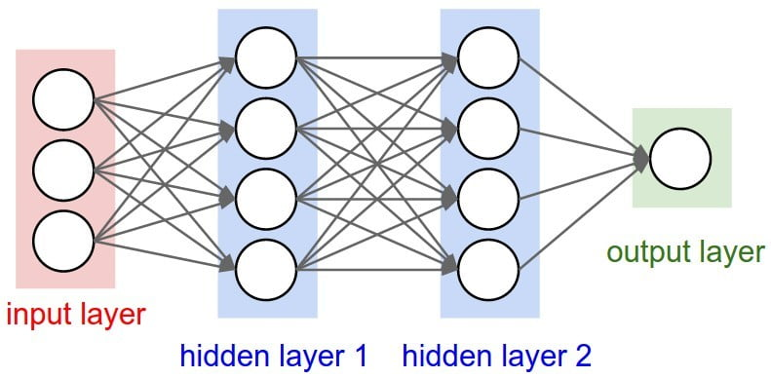
Diagram

Slide 12
Code
# Importing the libraries
import numpy as np
import matplotlib.pyplot as plt
import pandas as pd
# Importing the dataset
dataset = pd.read_csv("merged1.csv")
X = dataset.iloc[:,0:31].values
y = dataset.iloc[:,31:32].values
# Splitting the dataset into the Training set and Test set
from sklearn.cross_validation import train_test_split
X_train, X_test, y_train, y_test = train_test_split(X, y, test_size = 0.25, random_state = 0)
# Feature Scaling
from sklearn.preprocessing import StandardScaler
sc = StandardScaler()
X_train = sc.fit_transform(X_train)
X_test = sc.transform(X_test)
#importing the keras libraries and packages
import keras
from keras.models import Sequential
from keras.layers import Dense

Slide 13
Contd…
#Initialising the ANN
classifier = Sequential()
#Adding the input layer and the first hidden layer
classifier.add(Dense(output_dim = 16, init = 'uniform' , activation = 'relu', input_dim = 31 ))
#Adding the second hidden layer
classifier.add(Dense(output_dim = 16, init = 'uniform' , activation = 'relu' ))
#Adding the third hidden layer
classifier.add(Dense(output_dim = 16, init = 'uniform' , activation = 'relu' ))
#Adding the output layer
classifier.add(Dense(output_dim = 1, init = 'uniform' , activation = 'sigmoid' ))
#Compiling the ANN
classifier.compile(optimizer = 'adam', loss = 'binary_crossentropy', metrics = ['accuracy'])
#Fitting the ANN to the training set
classifier.fit(X_train, y_train, batch_size = 10, nb_epoch = 100 )
# Predicting the Test set results
y_pred = classifier.predict(X_test)
y_pred = (y_pred > 0.5)
# Making the Confusion Matrix
from sklearn.metrics import confusion_matrix
cm = confusion_matrix(y_test, y_pred)

Slide 14
Advantages
Corruption of one or more cells of ANN does not prevent it from generating output. This feature makes the networks fault tolerant.
It gave an accuracy of 90.5% on the test set of same dataset which we used for random forest classifier.

Slide 15
OVERVIEW
Earlier our model was designed with accuracy of 90.5 % but we didn’t test it’s prediction ability on a random dataset.
So, we have covered next objective of our project which is to predict damaged or undamaged condition of our structure.

Slide 16
LITERATURE SURVEY: II PAPER
Developed a damage identification and localization technique for civil structures using convolutional neural networks (based on LeNet-5, AlexNet-8, ZFNet-8, and Google-Net(inception v1)-22).
Applied region-based convolutional neural networks (Faster-RCNN) to damage detection in real-time.
Note: This project is mostly an application for masonry historic structures using fine-tuned deep learning algorithms. If you are more interested in the CNN architecture or implementation, there might not be much details. This project is aim to provide insights on artificial intelligence for infrastructural engineering.
Manual inspection (i.e., visual inspection and/or with professional equipment) is the most predominant approach for identifying and assessing superficial damage of masonry historic structures at present. However, this method is costly and at times difficult to apply to remote structures or components. Existing convolutional neural network (CNN)‐based damage detection methods have not been specifically designed for the multiple damage identification of masonry historic structures. To overcome these limits, a deep architecture of CNN damage classification techniques for masonry historic structures is proposed in this article using a

Slide 17
sliding window‐based CNN method to identify and locate four categories of damage (intact, crack, efflorescence, and spall) with an accuracy of 94.3%. This is the first attempt to identify the multi-damage of historic masonry structures based on CNN techniques and achieve excellent classification results. The data are only trained and tested from images of the Forbidden City Wall in China, and the pixel resolutions of stretcher brick images and header brick images are 480 × 105 and 210 × 105, respectively. Two CNNs (Alex-Net and Google-Net) are both trained on a small dataset (2,000 images for training, 400 images for validation and testing) and a large dataset (20,000 images for training, 4,000 images for validation and testing). The performance of the trained model (94.3% accuracy) is examined on five new images with 1,860 × 1,260 pixel resolutions.
Implementation
A Few Takeaways: If you are really into the algorithm, I would suggest you take Stanford CS231N first which is a really popular open course. If you are not very confident in Machine Learning, both Stanford CS229 and Berkeley CS189 are good resources. I would also suggest reading those papers presenting deep learning architectures that are among the top ranks in recent CV classification/object detection competitions.
Dataset: You can either use our dataset or create your own dataset! Just take as many pictures of what your are interested in researching as possible. You might also want to use the crowdsourcing technology to let so many other people collect data for you!
Training: The training environment depends on your dataset and CNNs. For example, if your dataset is large (GB/TB/PB), you might consider using distributed workstations instead of PCs, which also applies to deeper CNNs (ResNet, Inception v-4, etc.). You might also need GPU(s) for computing since it is much more faster that CPU-only.
For tools training the dataset, I would suggest using TensorFlow or PyTorch. But if you are only into the application, Caffe is fine. If you choose Caffe, the only thing you need to do is to change the hyperparameters in the .prototxt files.

Slide 18
REFERENCES
Franklin Zhao (me:))
Xuefeng Zhao (my undergraduate advisor who supported this project)
Peng Zhao (provided the data-set for this project)
June 2017

Slide 19
III PAPER
During the long-term operation of hydro-junction infrastructure, water flow erosion causes concrete surfaces to crack, resulting in seepage, spalling, and rebar exposure. To ensure infrastructure safety, detecting such damage is critical. We propose a highly accurate damage detection method using a deep convolutional neural network with transfer learning. First, we collected images from hydro-junction infrastructure using a high-definition camera. Second, we preprocessed the images using an image expansion method. Finally, we modified the structure of Inception-v3 and trained the network using transfer learning to detect damage. The experiments show that the accuracy of the proposed damage detection method is 96.8%, considerably higher than the accuracy of a support vector machine. The results demonstrate that our damage detection method achieves better damage detection performance.

Slide 20
REFERENCES
Authors
Authors and affiliations
Chuncheng Feng Hua Zhang
Shuang Wang
Yonglong Li
Haoran Wang
Fei Yan
1. 2. 3. Structural Engineering
First Online: 03 September 2019
73Downloads

Slide 21
PROCEDURE
We have taken two datasets one is damaged and other one is undamaged from Qatar University’s website.
Random values has been taken from damaged dataset and undamaged dataset which is passed in the form of array and based on classifier’s output we predict whether that structure is damaged or not.

Slide 22
ALGORITHM
# Importing the libraries
import numpy as np
import matplotlib.pyplot as plt
import pandas as pd
# Importing the dataset
dataset = pd.read_csv("merged1.csv")
X = dataset.iloc[:,0:31].values
y = dataset.iloc[:,31:32].values
# Splitting the dataset into the Training set and Test set
from sklearn.cross_validation import train_test_split
X_train, X_test, y_train, y_test = train_test_split(X, y, test_size = 0.25, random_state = 0)
# Feature Scaling
from sklearn.preprocessing import StandardScaler
sc = StandardScaler()
X_train = sc.fit_transform(X_train)
X_test = sc.transform(X_test)

Slide 23
#importing the keras libraries and packages
import keras
from keras.models import Sequential
from keras.layers import Dense
#Initialising the ANN
classifier = Sequential()
#Adding the input layer and the first hidden layer
classifier.add(Dense(output_dim = 16, init = 'uniform' , activation = 'relu', input_dim = 31 ))
#Adding the second hidden layer
classifier.add(Dense(output_dim = 16, init = 'uniform' , activation = 'relu' ))
#Adding the third hidden layer
classifier.add(Dense(output_dim = 16, init = 'uniform' , activation = 'relu' ))
#Adding the output layer
classifier.add(Dense(output_dim = 1, init = 'uniform' , activation = 'sigmoid' ))

Slide 24
#Compiling the ANN
classifier.compile(optimizer = 'adam', loss = 'binary_crossentropy', metrics = ['accuracy'])
#fitting ANN to the Training set
classifier.fit(X_train, y_train, batch_size =10 , nb_epoch = 100)
# Predicting the Test set results
y_pred = classifier.predict(X_test)
y_pred = classifier.predict(sc.transform(np.array([[0.00E+00,0.004954129,-0.00135893,0.004767455,-0.008526795,-0.00118725,0.004382603,-0.000651758,-0.03157736,-0.007815173,0.00280153,0.00610745,0.005736843,0.005886622,0.00395724,-0.001407764, 0.001572102, -0.001740023, -0.001308009, 0.003346061, -0.000695411 ,0.000771683, -0.001459152 ,0.002673313, -0.001022762 ,0.000871385, -0.003662355 ,0.005480237, -0.004953712, 0.003154866, -0.002783455]
])))
if (y_pred>0.5):
y_pred = True
else:
y_pred = False

Slide 25
y_pred2 = classifier.predict(sc.transform(np.array([[2.93E-03, -0.01978657, 0.005272564, -0.003470697, 0.004499115, -0.02361103, 0.004458822, 0.0128046, 0.02860562, 0.009632573, 0.0045349 ,-0.004647456, 0.0162496 ,-0.01543104, 0.01038449, -0.0140401, 0.005387217, -0.004955489, 0.009316035, -0.003598712, 0.006795108, -0.001712944, 0.007826921, 0.000537507, 0.009287003, 0.000920057, -0.001097824 ,-0.00259589 ,0.01336877 ,-0.00136384 ,0.003096842]])))
if (y_pred2>0.5):
y_pred2 = True
else:
y_pred2 = False

Slide 26
y_pred3 = classifier.predict(sc.transform(np.array([[1.56E-02, -0.05745137 ,-0.01929993, -0.01470184 ,0.01333202 ,-0.04396094, -0.04732147 ,-0.04605642 ,-0.006040871 ,-0.04604396 ,-0.03166394 ,-0.0208198 ,0.02659251 ,-0.05626581 ,0.0307616 ,-0.03393319, 0.03228329 ,0.009362843, 0.01875691 ,-0.001492471 ,0.03549647 ,-0.0688064 ,0.01738056 ,-0.04961761, 0.01526522 ,-0.06686546, 0.02153684 ,-0.02995655, 0.0701599, -0.03773249 ,0.02832786]])))
if (y_pred3>0.5):
y_pred3 = True
else:
y_pred3 = False
y_pred4 = classifier.predict(sc.transform(np.array([[1.07E-02 ,0.02266581 ,-0.05025517 ,0.04628153 ,-0.05691658, 0.008091589 ,0.02481791, 0.020448 ,-0.04353936 ,0.002702039 ,0.02185528 ,-0.03014893 ,-0.01361173 ,0.003174966 ,-0.01348101 ,-0.03064758 ,0.01970412 ,-0.02633141 ,-0.001082268 ,-0.02214634 ,0.01889488 ,0.007505111 ,0.0216178 ,0.007586624, 0.02598811 ,0.01304164 ,-0.01933327 ,-0.003960259 ,-0.003659457 ,-0.006797105 ,-0.0148313]])))
if (y_pred4>0.5):
y_pred4 = True
else:
y_pred4 = False

Slide 27
y_pred5 = classifier.predict(sc.transform(np.array([[2.64E-02 ,0.05141491, 0.1371299, 0.01410442, 0.05277888, 0.08098627, 0.0765454, -0.03402597, -0.03920335, 0.009691, 0.03192964, 0.03976386, 0.01606074, 0.01855531, -0.01870973, 0.08450627, -0.0469705, 0.00365792, -0.02952722, 0.02933582, -0.0469683, 0.07505307, -0.04142286, 0.024223, -0.07352217, 0.06647334, -0.06438492, 0.07537909, -0.1402242, 0.08180247, -0.06571731]])))
if (y_pred5>0.5):
y_pred5 = True
else:
y_pred5 = False

Slide 28
y_pred6 = classifier.predict(sc.transform(np.array([[1.86E-02 ,-0.02970519 ,-0.146157 ,-0.01000619 ,-0.06614485 ,-0.1572252 ,-0.04276229 ,0.1335134 ,-0.3211988 ,0.07301298 ,-0.01995921 ,-0.1028809 ,0.001871698 ,-0.03145802 ,0.006327968 ,-0.118453 ,0.07570876 ,-0.0677254 ,0.04361693 ,-0.08076902 ,0.07341506 ,-0.05298574 ,0.05783384 ,-0.04011805 ,0.05608254 ,-0.06115766 ,0.0548408 ,-0.1656903 ,0.09615924 ,-0.1994943 ,0.03413431]])))
if (y_pred6>0.5):
y_pred6 = True
else:
y_pred6 = False
# Making the Confusion Matrix
from sklearn.metrics import confusion_matrix
cm = confusion_matrix(y_test, y_pred)

Slide 29
Result
Obtained an accuracy of 90.5% on the test set of merged dataset containing both damaged and undamaged data.
Need accelerometer readings to test our initial model made.

Slide 30
RESULT 2
Our model now can be used to predict whether the structure is damaged or undamaged even by passing arbitrary data.

Slide 31
FUTURE SCOPE
Until now we have made classification on basis of damaged and undamaged so we will progress our work to classify on basis of which joint was damaged of a specific floor.
Use of Tensorflow library to implement Android App to improve usability of our model.

Slide 32
FUTURE SCOPE 2
Need to classify on basis of which joint was damaged of a specific floor.
Use of Tensorflow library to implement Android App to improve usability of our model.

Slide 33
OVERVIEW
Earlier we predicted whether joint was damaged or undamaged.
Now our next objective was to be predict which joint was damaged or undamaged.

Slide 34
LITERATURE SURVEY IV
Abstract—In today’s world, structural development with reliability and integrity is an ever demanding process. Fault detection is the identification of normal healthy behavior of a system or process and recognition of any deviation from such normal behavior. Fault detection in structural systems provides important liability and financial advantages since it gives the decision-makers lead-time and flexibility to manage the health of the system. Structural systems are critical systems that require continuous monitoring of damage accumulation caused by earthquake loads that may cause catastrophic failures. We present in this research a data-driven methodology for fault detection of structural systems using multivariate statistical process control (MVSPC). The proposed method based on modeling overall structural damage using artificial neural networks (ANN) as a function of the earthquake load intensity. Hotelling ࢀ ૛technique is then used to identify any shifts of the ANN model weights from their healthy states. The proposed method is tested and validated using simulation data fora four-story RC building with varying concrete strengths. The methodology presented in this paper is scalable and can be applied to a wide range of systems to assess their health via an inspection check to anticipate and potentially avoid failures. Keywords— Structural damage, profile monitoring, multivariate statistical process control. I. INTRODUCTION With the advent of new technologies, structural systems are becoming much more complicated and the need for high reliability is of surmounting importance. Moreover, technology development increased significantly the amount of data measured and collected of structural integrity over time. Fault detection is the extraction of underlying structural information from collected data, identification of normal structures and recognition of departures from such normal structural conditions. This can be done by modeling the response of a healthy structure under different loading conditions, and identifying faults by monitoring model parameters and detecting any departure of these parameters from the normal

Slide 35
classes or clusters. Models describing the behavior of structures involve many input variables as well as output variables. The use of fault detection is a key strategy used by decision-makers to avoid major failures, improve maintenance efficiency, and decrease the liability cost of these systems. Structural systems are critical systems that require continuous monitoring of damage accumulation caused by seismic activity that may cause failures of severe consequences. The aim of this article is to model structural damage as a function of structure and load characteristics such as story levels and earthquake intensity measure (Peak Ground Acceleration, PGA) then utilizes the model to detect any faulty states, i.e. damaged structures by comparing it to healthy conditions. The organization of the reminder of this article is as follow: the related literature is presented in section two while methodology is outlined in section three. Section four includes the results of the study while conclusions and future research recommendations are presented in the last section. II. LITERATURE REVIEW Literature is rich of fault detection methods and techniques with wide applications on industrial and structural systems. More details on such methods and techniques, its advantages and limitations are presented in the following sections. A. Fault detection Complex systems can be characterized by a relationship between a response and one or more explanatory variables usually referred to as profile [1]. The majority of fault detection techniques relies on profile comparisons through comparing model coefficients or error terms or both to detect any departure from an acceptable common variability region of these comparators. Under normal conditions, i.e. healthy state, only small differences between these profile indicators are allowed.

Slide 36
CONCLUSION
A flexible ANN-based profile monitoring method was proposed to detect faulty structures based on computer simulation models of structural damage under seismic loading. Five of the six known faulty profiles were immediately detected. The remainder faulty profile was recognized after one cycle of refinement (removal of faulty states from the pool of known healthy states). The methodology presented in this paper is scalable and can be applied to a wide range of systems to assess their health from an inspection check to anticipate and avoid failures. Accordingly, the ability of the proposed method to detect structural damage in different structural sizes and configurations will be the focus of future relevant research.

Slide 37
REFERENCES
[1] D. C. Montgomery, Introduction to Statistical Quality Control, 7th edition., New York: Wiley and Sons Inc., 2015.
[2] N. Vichare and M. Pecht, "Prognostics and health management of electronics," IEEE Transactions on Components and Packaging Technologies, vol. 29, no. 1, 2006.
[3] B. Ferrell, , "JSF Prognostics and Health Management," in IEEE Aerospace Conference, 1999.
[4] M. Pepe, The Statistical Evaluation of Medical Tests for Classification and Prediction, Oxford, UK: Oxford University Press, 2003.
[5] O. Gusikhin, N. Rychtyckyj and D. Filev, "Intelligent Systems in the Automotive Industry: Applications and Trends," Knowledge and Information Systems, vol. 12, pp. 147-168, 2007.
[6] P. M. Winistorfer, T. M. Young and E. Walker, "Modeling and Comparing Vertical Density Profiles," Wood and Fiber science , vol. 29, no. 1, pp. 133-140, 1996.
[7] L. Kang and S. L. Albin, "On-line Monitoring When the Process Yields a Linear Profile," Journal of Quality Technology, vol. 32, pp. 418-426., 2000.
[8] M. Mahmoud, "Phase I analysis of multiple regressionlinear profiles," Communications in statistics, Simulation and Computation, vol. 37, no. 10, pp. 2106-2130, 2008.
[9] Y. Ding, L. Zeng and S. Zhou, "Phase I analysis for monitoring nonlinear profiles in manufacturing processes," Journal of Quality Technology , vol. 38, p. 199–216, 2006.

Slide 38
LITERATURE SURVEY V
ABSTRACT : A seismic damage index monitoring system is presented in this paper. The method is based on artificial neural networks and measured responses of the structure. Park & Ang damage index is selected for monitoring the damage at each story of the structure. The system is consisted of two neural networks. The input to the first NN is the maximum drift of each story and the output is the damage due to maximum drift of the story. Also the input to the second NN is the differential drift and the sum of the accelerations of stories above each story. The Output of the second NN is the cumulative damage of the story. The data needed for training of neural networks are collected from analysis of a simulated model of the structure under different earthquake records. The damage index in each analysis is computed from analytical method. The performance of damage detection system is determined from comparison of damage index computed from analytical method to one determined by neural networks in a three story benchmark building. Through this study, it is shown that the proposed approach has the potential of being a practical tool for damage monitoring methodology applied to smart civil structures. KEYWORDS: Damage Index, Monitoring, Neural Network, Earthquake 1. INTRODUCTION Owing to improved instrumentation and understanding of the dynamics of the complex structures, efforts to identify structural damage have received increasing attention recently. Among many damage detection techniques, the vibration-based approach is promising because it is nondestructive and the vibration signal of a structure is easily measurable using properly deployed sensors. During the last few decades, various vibration-based methods have been developed and applied to detect structural damage in numerous areas . These methods are based on the fact that structural damages reduce the structural stiffness, changing the dynamic characteristics of the structures. Structural damage detection methods used natural frequencies to indicate damage in earlier research [1-4

Slide 39
]. However, the frequencies are not spatially specific, nor are they sensitive to damage, thus limiting their application. Since mode shapes can provide much more information than natural frequencies, many studies have focused on damage detection using mode shape information [5–7]. Another set of techniques for detecting structural damage use change in modal strain energy [8-9]. Owing to the features of robustness, fault tolerance, and powerful computational ability, the ANN models have become a promising tool for solving civil engineering problems. Some researches have examined the suitability and capabilities of ANNs for damage detection [10-14]. On-line monitoring has become indispensable for an effective active structural control system, and recent development of sensors and computer technologies renders integration of the on-line monitoring component into a control system feasible. A methodology is needed to analyze the measurement data in order to continuously assess the structural performance or health condition and, therefore, an appropriate control action can be taken to effectively suppress the structural response to an environmental loading.

Slide 40
REFERENCES
1. Cawley P, Adams RD. (1979).The location of defects in structures from measurements of natural frequencies. Journal of Strain Analysis 14:2,49–57.
2. Penny JET, Wilson D, Friswell MI. (1993).Damage location in structures using vibration data. Proceedings of the 11th International Modal Analysis Conference, Kissimee,; 861–867.
3. Contursi T, Messina A, Williams EJ. (1998).A multiple-damage location assurance criterion based on natural frequency changes. Journal of Vibration and Control; 4:5,619–663.
4. Messina A, Jones IA, Williams EJ. (1996).Damage detection and localization using natural frequency changes. Proceedings of the Conference on Identification in Engineering Systems, Swansea, 67–76.
5. Biswas M, Pandey AK, Samman MM. (1990).Diagnosis experiment spectral/modal analysis of highway bridges. The International Journal of Analytical and Experimental Modal Analysis 5:1,33–42.
6. Topole KG, Stubbs N. (1995).Non-destructive damage evaluation of a structure from limited modal parameters. Earthquake Engineering and Structural Dynamics 24(12,1427–1436.

Slide 41
PROCEDURE
To detect which joint was damaged , we had created two model.
First model uses ANN and it is used to predict whether joint was damaged or not.
Second model uses Random Forest Regresssion to predict which joint was damaged.

Slide 42
ALGORITHM
In ANN we have added 0 and 1 to dataset for detecting damaged and undamaged condition for a joint.
In Random Forest Regression we added integer corresponding to a joint to detect which joint was damaged.

Slide 43
CODE
# Importing the libraries
importnumpy as np
importmatplotlib.pyplot as plt
import pandas as pd
# Importing the dataset
dataset = pd.read_csv("zzzAD3.csv")
X = dataset.iloc[:,0:31].values
y = dataset.iloc[:,31:32].values
fromsklearn.model_selection import KFold
cv = KFold(n_splits=10, random_state=90, shuffle=False)
fortrain_index, test_index in cv.split(X):
X_train, X_test, y_train, y_test = X[train_index], X[test_index], y[train_index], y[test_index]
# Splitting the dataset into the Training set and Test set
#from sklearn.cross_validation import train_test_split
#X_train, X_test, y_train, y_test = train_test_split(X, y, test_size = 0.25, random_state = 0)
# Feature Scaling
fromsklearn.preprocessing import StandardScaler
sc = StandardScaler()
X_train = sc.fit_transform(X_train)
X_test = sc.transform(X_test)
#importing the keras libraries and packages
importkeras
fromkeras.models import Sequential
fromkeras.layers import Dense
fromkeras.layers import Dropout

Slide 44
#Initialising the ANN
classifier3 = Sequential()
#Adding the input layer and the first hidden layer
classifier3.add(Dense(output_dim = 10, init = 'uniform' , activation = 'relu', input_dim = 31 ))
classifier3.add(Dropout(0.75))
#Adding the second hidden layer
#Adding the output layer
classifier3.add(Dense(output_dim = 1, init = 'uniform' , activation = 'sigmoid' ))
#Compiling the ANN
classifier3.compile(optimizer = 'adam', loss = 'binary_crossentropy', metrics = ['accuracy'])
#fitting ANN to the Training set
classifier3.fit(X_train, y_train, batch_size =262000 , nb_epoch = 10,
validation_data=(X_test,y_test))
fromsklearn.metrics import confusion_matrix
cm = confusion_matrix(y_test, y_pred)

Slide 45
Earlier we thought about making model for every joint , then importing them all in one file and using that for detection.
But due to over fitting we were unable to do so.
So we have used ANN and Random forest Regression together.

Slide 46
ANN Code
# Importing the libraries
importnumpy as np
importmatplotlib.pyplot as plt
import pandas as pd
# Importing the dataset
dataset = pd.read_csv("merged2.csv")
X = dataset.iloc[:,0:31].values
y = dataset.iloc[:,31:32].values
# Splitting the dataset into the Training set and Test set
fromsklearn.model_selection import train_test_split
X_train, X_test, y_train, y_test = train_test_split(X, y, test_size = 0.25, random_state = 0)
# Feature Scaling
fromsklearn.preprocessing import StandardScaler
sc = StandardScaler()
X_train = sc.fit_transform(X_train)
X_test = sc.transform(X_test)
#importing the keras libraries and packages
importkeras
fromkeras.models import Sequential
fromkeras.layers import Dense
#Initialising the ANN
classifier = Sequential()
#Adding the input layer and the first hidden layer
classifier.add(Dense(output_dim = 16, init = 'uniform' , activation = 'relu', input_dim = 31 ))

Slide 47
#Adding the second hidden layer
classifier.add(Dense(output_dim = 16, init = 'uniform' , activation = 'relu' ))
#Adding the third hidden layer
classifier.add(Dense(output_dim = 16, init = 'uniform' , activation = 'relu' ))
#Adding the output layer
classifier.add(Dense(output_dim = 1, init = 'uniform' , activation = 'sigmoid' ))
#Compiling the ANN
classifier.compile(optimizer = 'adam', loss = 'binary_crossentropy', metrics = ['accuracy'])
#fitting ANN to the Training set
classifier.fit(X_train, y_train, batch_size =1000 , nb_epoch = 100)
# Predicting the Test set results
y_pred = classifier.predict(X_test)
y_pred = classifier.predict(sc.transform(np.array([[0.00E+00,0.004954129,-0.00135893,0.004767455,-0.008526795,-0.00118725,0.004382603,-0.000651758,-0.03157736,-0.007815173,0.00280153,0.00610745,0.005736843,0.005886622,0.00395724,-0.001407764, 0.001572102, -0.001740023, -0.001308009, 0.003346061, -0.000695411 ,0.000771683, -0.001459152 ,0.002673313, -0.001022762 ,0.000871385, -0.003662355 ,0.005480237, -0.004953712, 0.003154866, -0.002783455]
])))
if (y_pred>0.5):
y_pred = True
else:
y_pred = False

Slide 48
y_pred2 = classifier.predict(sc.transform(np.array([[2.93E-03, -0.01978657, 0.005272564, -0.003470697, 0.004499115, -0.02361103, 0.004458822, 0.0128046, 0.02860562, 0.009632573, 0.0045349 ,-0.004647456, 0.0162496 ,-0.01543104, 0.01038449, -0.0140401, 0.005387217, -0.004955489, 0.009316035, -0.003598712, 0.006795108, -0.001712944, 0.007826921, 0.000537507, 0.009287003, 0.000920057, -0.001097824 ,-0.00259589 ,0.01336877 ,-0.00136384 ,0.003096842]])))
if (y_pred2>0.5):
y_pred2 = True
else:
y_pred2 = False
y_pred3 = classifier.predict(sc.transform(np.array([[1.56E-02, -0.05745137 ,-0.01929993, -0.01470184 ,0.01333202 ,-0.04396094, -0.04732147 ,-0.04605642 ,-0.006040871 ,-0.04604396 ,-0.03166394 ,-0.0208198 ,0.02659251 ,-0.05626581 ,0.0307616 ,-0.03393319, 0.03228329 ,0.009362843, 0.01875691 ,-0.001492471 ,0.03549647 ,-0.0688064 ,0.01738056 ,-0.04961761, 0.01526522 ,-0.06686546, 0.02153684 ,-0.02995655, 0.0701599, -0.03773249 ,0.02832786]])))
if (y_pred3>0.5):
y_pred3 = True
else:
y_pred3 = False
y_pred4 = classifier.predict(sc.transform(np.array([[1.07E-02 ,0.02266581 ,-0.05025517 ,0.04628153 ,-0.05691658, 0.008091589 ,0.02481791, 0.020448 ,-0.04353936 ,0.002702039 ,0.02185528 ,-0.03014893 ,-0.01361173 ,0.003174966 ,-0.01348101 ,-0.03064758 ,0.01970412 ,-0.02633141 ,-0.001082268 ,-0.02214634 ,0.01889488 ,0.007505111 ,0.0216178 ,0.007586624, 0.02598811 ,0.01304164 ,-0.01933327 ,-0.003960259 ,-0.003659457 ,-0.006797105 ,-0.0148313]])))
if (y_pred4>0.5):
y_pred4 = True
else:
y_pred4 = False

Slide 49
y_pred5 = classifier.predict(sc.transform(np.array([[2.64E-02 ,0.05141491, 0.1371299, 0.01410442, 0.05277888, 0.08098627, 0.0765454, -0.03402597, -0.03920335, 0.009691, 0.03192964, 0.03976386, 0.01606074, 0.01855531, -0.01870973, 0.08450627, -0.0469705, 0.00365792, -0.02952722, 0.02933582, -0.0469683, 0.07505307, -0.04142286, 0.024223, -0.07352217, 0.06647334, -0.06438492, 0.07537909, -0.1402242, 0.08180247, -0.06571731]])))
if (y_pred5>0.5):
y_pred5 = True
else:
y_pred5 = False
y_pred6 = classifier.predict(sc.transform(np.array([[1.86E-02 ,-0.02970519 ,-0.146157 ,-0.01000619 ,-0.06614485 ,-0.1572252 ,-0.04276229 ,0.1335134 ,-0.3211988 ,0.07301298 ,-0.01995921 ,-0.1028809 ,0.001871698 ,-0.03145802 ,0.006327968 ,-0.118453 ,0.07570876 ,-0.0677254 ,0.04361693 ,-0.08076902 ,0.07341506 ,-0.05298574 ,0.05783384 ,-0.04011805 ,0.05608254 ,-0.06115766 ,0.0548408 ,-0.1656903 ,0.09615924 ,-0.1994943 ,0.03413431]])))
if (y_pred6>0.5):
y_pred6 = True
else:
y_pred6 = False
# Making the Confusion Matrix
fromsklearn.metrics import confusion_matrix
cm = confusion_matrix(y_test, y_pred)

Slide 50
Random Forest Regression Code
importnumpy as np
importmatplotlib.pyplot as plt
import pandas as pd
# Importing the dataset
dataset1 = pd.read_csv('merged1.csv')
X1 = dataset1.iloc[:, 0:31].values
y1 = dataset1.iloc[:, 31:].values
# Splitting the dataset into the Training set and Test set
fromsklearn.cross_validation import train_test_split
X1_train, X1_test, y1_train, y1_test = train_test_split(X1, y1, test_size = 0.25, random_state = 0)
# Feature Scaling
fromsklearn.preprocessing import StandardScaler
sc1 = StandardScaler()
X1_train = sc1.fit_transform(X1_train)
X1_test = sc1.transform(X1_test)
y1_train=y1_train.reshape(589823,1)
#Fitting Random Forest Regression to the dataset
fromsklearn.ensemble import RandomForestRegressor
regressor = RandomForestRegressor(n_estimators = 10, random_state = 0)
regressor.fit(X1_train,y1_train.ravel())

Slide 51
# Visualising the Random Forest Regression results (higher resolution)
# Predicting the Test set results
y_pred1 = regressor.predict(X1_test)
y_pred1 = regressor.predict(sc1.transform(np.array([[0.00E+00,0.004954129,-0.00135893,0.004767455,-0.008526795,-0.00118725,0.004382603,-0.000651758,-0.03157736,-0.007815173,0.00280153,0.00610745,0.005736843,0.005886622,0.00395724,-0.001407764, 0.001572102, -0.001740023, -0.001308009, 0.003346061, -0.000695411 ,0.000771683, -0.001459152 ,0.002673313, -0.001022762 ,0.000871385, -0.003662355 ,0.005480237, -0.004953712, 0.003154866, -0.002783455]
])))
int(np.ceil(y_pred1))
fromsklearn.metrics import confusion_matrix
cm = confusion_matrix(y1_test, y_pred1)

Slide 52
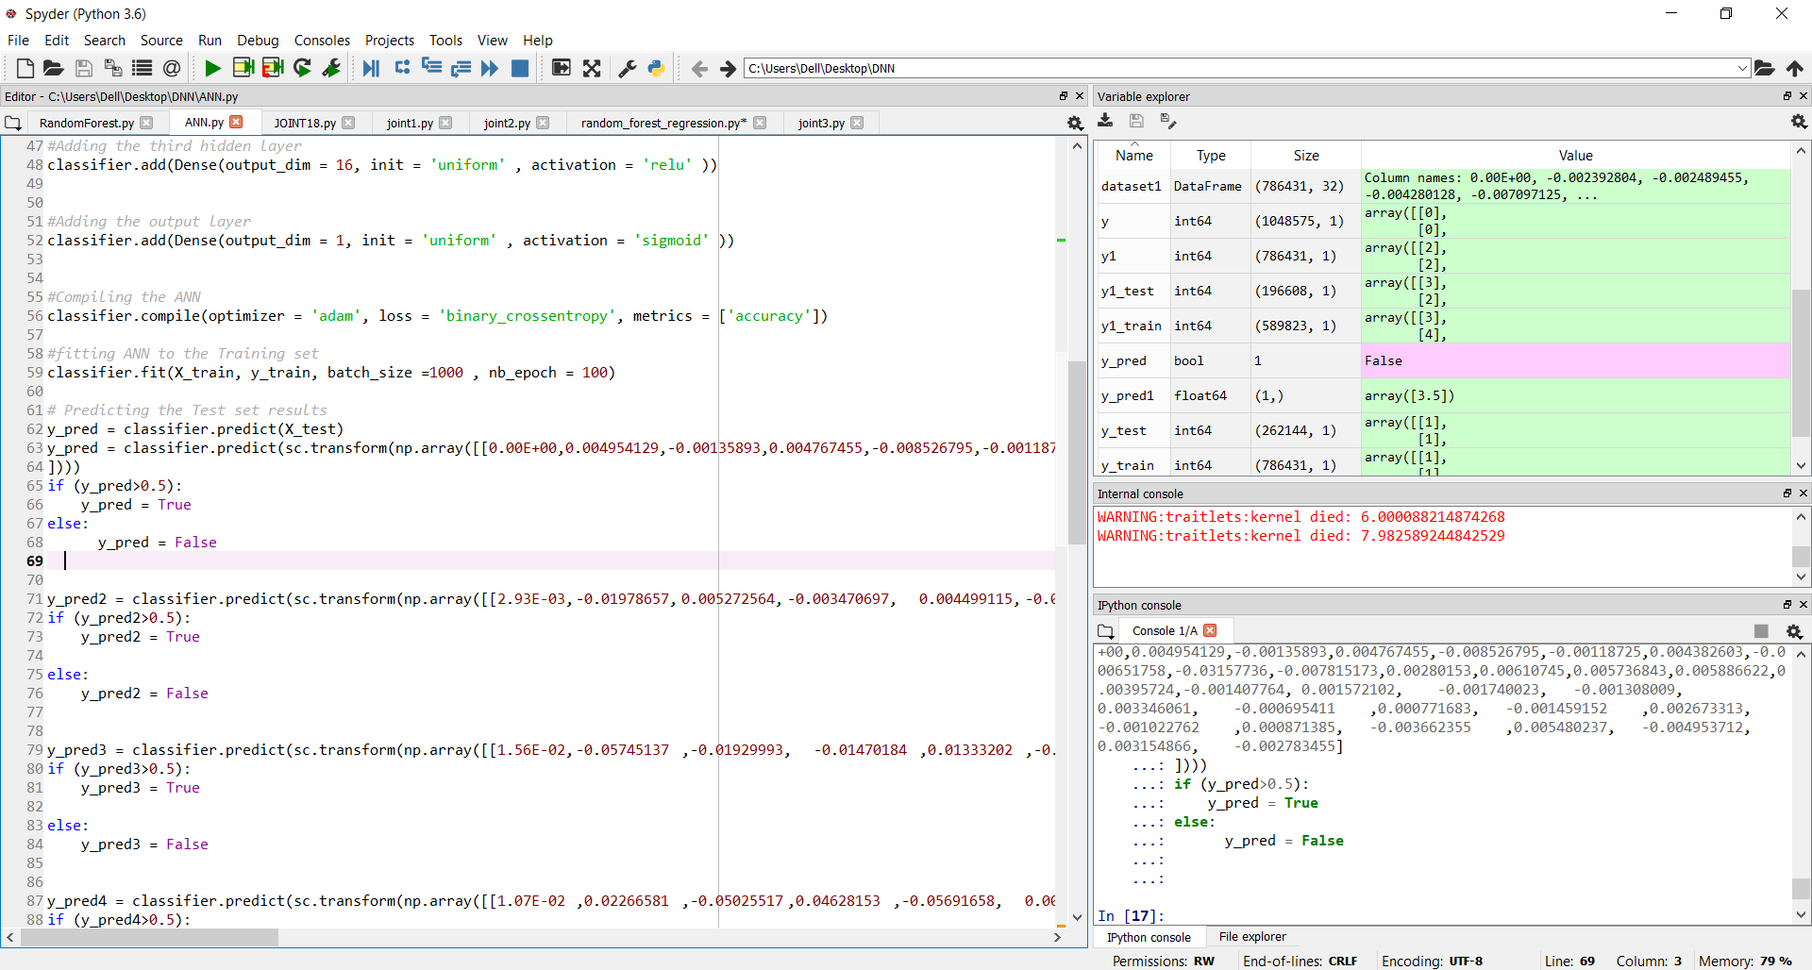
RESULT OF ANN

Slide 53
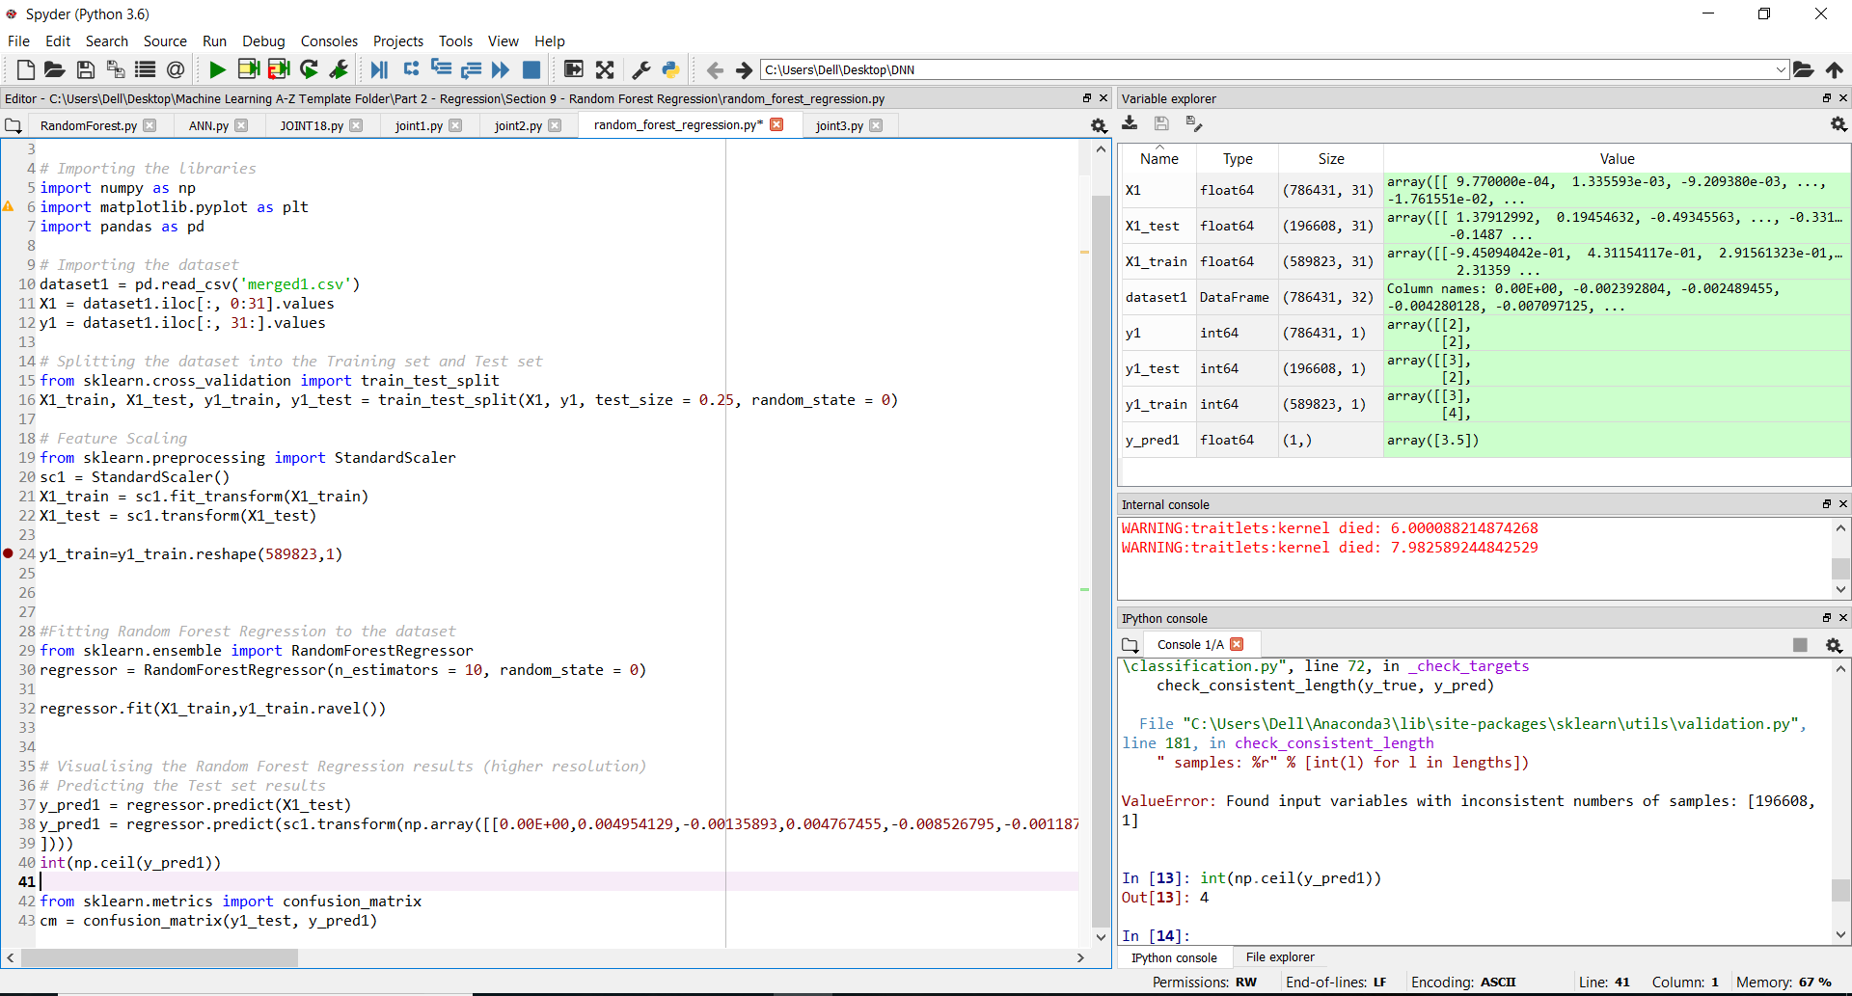
RESULT OF REGRESSION

Slide 55
THANK YOU

